Slide 1




ENGLISH LANGUAGE TEACHING
REFLECTIVE TEACHING: PRINCIPLES AND PRACTICES
Castro F. Chilaule

Slide 2
CONTENTS John M. Murphy
REFLECTIVE TEACHERS (RTs)
PURPOSES OF REFLECTIVE TEACHING
FEATURES OF REFLECTIVE TEACHING
COGNITIVE DIMENSIONS OF RTs
GENERAL AREAS OF RTs
REFERENCES

Slide 3
Who are Reflective Teachers?
“Gaining teaching experience, participating in teacher-development courses, thinking about and discussing published scholarship, attending conferences, consulting with colleagues and getting to know students better are but some of the ways English language teachers grow as professionals.”
Richards and Farrell (2005)

Slide 4
Purposes of Reflective Teaching
Expand our understandings of the teaching and learning process
Expand our repertoire of strategic options as language teachers
Take ownership of our own theories of language teaching as informed by teaching practice
Enhance the quality of learning opportunities we are able to provide in language classrooms

Slide 5
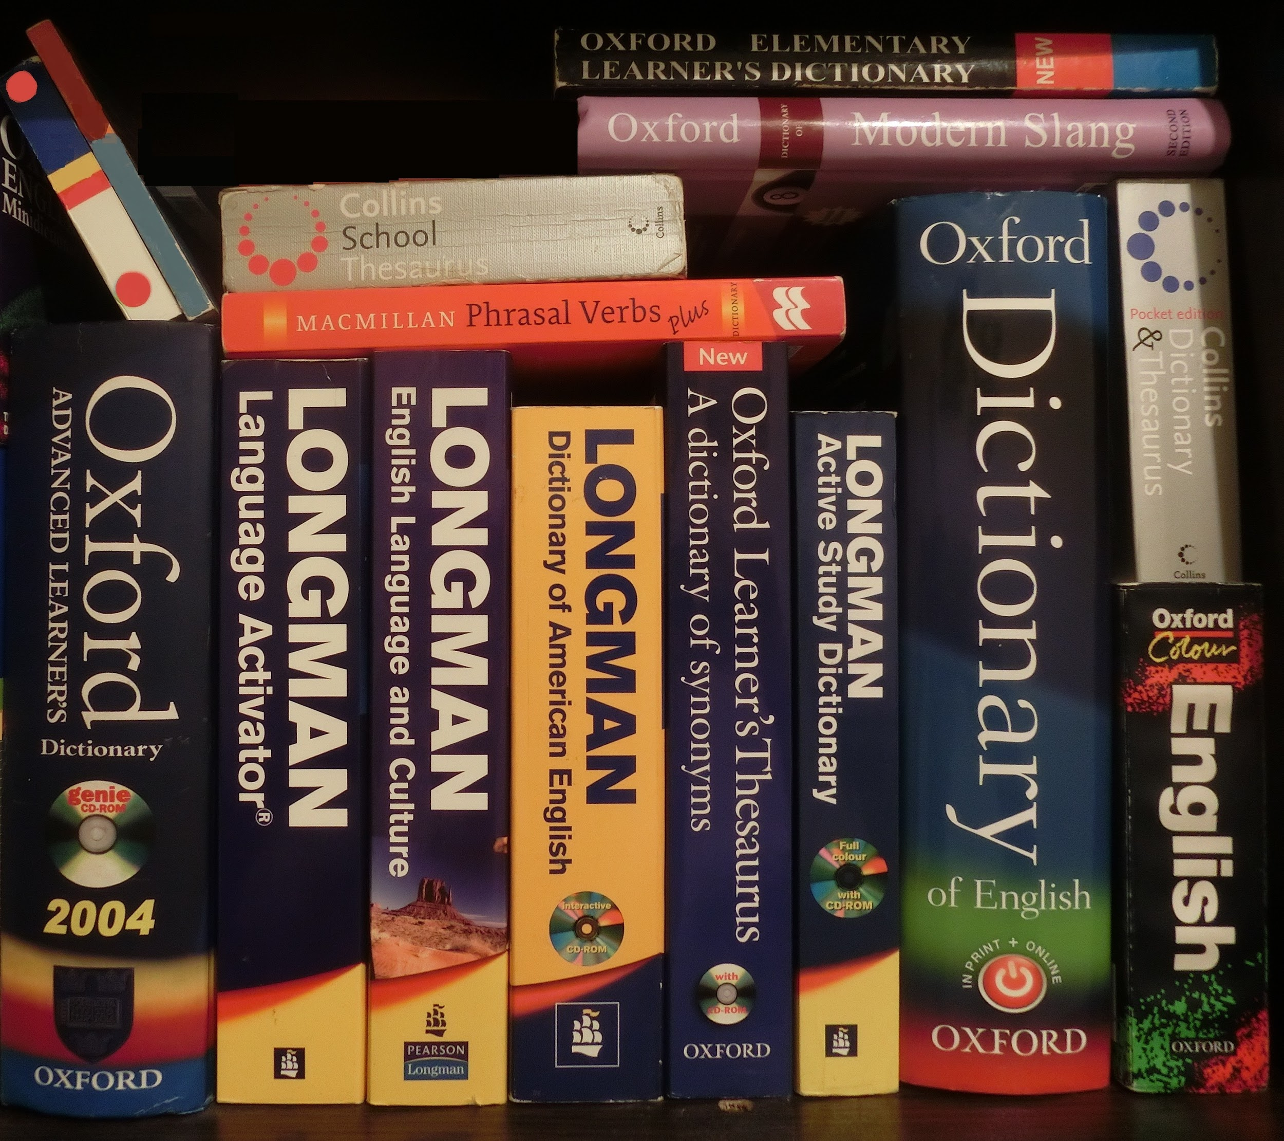
THREE
FEATURES
OF
REFLECTIVE
TEACHERS
Open-mindedness - the ability to remain attentive and receptive to different points of view
Responsibility - staying aware and being responsive to the consequences of our actions
Wholeheartedness - doing our best to situate our engagements with open-mindedness and to accept responsibility as the core of our professional lives

Slide 6
THREE COGNITIVE DIMENSIONS OF RTs
Reflection-in-action
It has to do with real time decisions, online process or during class hours
Reflection-on-action
It has to do with retrospective, how you performed and analyzing the strategies or techniques
Reflection-for-action
Planning ahead to make changes, explicitly proactive and future oriented

Slide 7
GENERAL AREAS OF RTs
Communication patterns in the classroom
Teacher decision making
Ways in which learners apply knowledge
The affective climate
Impacts of the classroom’s physical environment
Teacher’s self-assessment of growth and development as a professional

Slide 8

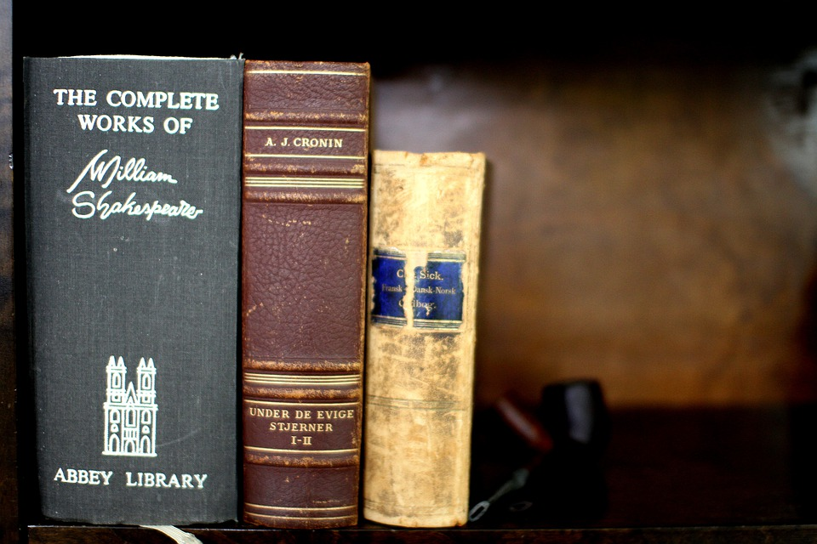
Thank you for your time
KANIMAMBO
Muito
Obrigado
God
Bless
You

